Slide 1

360 Learning
PRESENTED BY TEAM BRATS :
DEEPSHIKHA (RVS)
ABHISHEK CHANDRASEKARAN (RVS)

Slide 2
Table of contents:
INTRODUCTION
NEED OF PROJECT
IDEA
DESCRIPTION OF THE APPLICATION
FEATURES
FUTURE ENHANCEMENT

Slide 3

INTRODUCTION :
eBooks, apps and other digital relearning materials are easily accessible
and easy to carry, unlike the traditional learning materials.
From 2001 to 2017, the corporate online education industry has grown by
900%, and at least 42% of organizations that employed learning apps
have greatly boosted their profitability, according to the statistics by e-Learning industry.
eLearning is more sustainable than face-to-face learning in terms of the environment.
A study by The Open University found that “distance learning courses involve
87% less energy and 85% lower CO2 emissions than the full-time campus-based courses” .

Slide 4

Need of project:
It frees students to work at their own pace and give them time for other things.
It empowers one’s interacting powers, even the introverts feel free to interact.
eLearning methods allow them to study at home.
Online courses cater to an unlimited number of students
unlike the traditional way of learning where the number
per class is limited are allowed to enroll in this virtual world.

Slide 5

IDEA:
Our e-Learning app will feature a variety of courses in multiple subjects of various difficulty level and duration from different tutors around the world we can access it accordingly.
The courses will be available in three forms first is pre-recorded lectures, secondly webinars and third will be notes in the form of PDFs/Documents, anyone can access the courses as per there convenience.
We are introducing A gamified education service which will encourage a young audience to study while playing so that they won’t get bored easily
We will also be having a dashboard or profile of an individual where we will be showing the performance chart their progress etc.
Our app will feature a chat room or an online conferencing tool, which will let users to interact in real time, a discussion will be there,

Slide 6
DISCRIPTION OF the APPLICATION:
We will be creating an Android Application which will be having :
Splash Screen .
Login and sign up page .
Courses to enroll for and level of the course .
A personal dashboard consisting of course progress , to-do list and a section which will be showing badges earned, leader board and levels completed .
A chat room and discussion form .

Slide 7
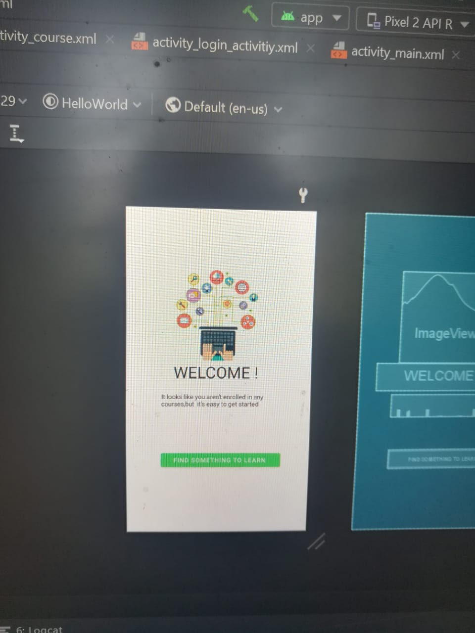
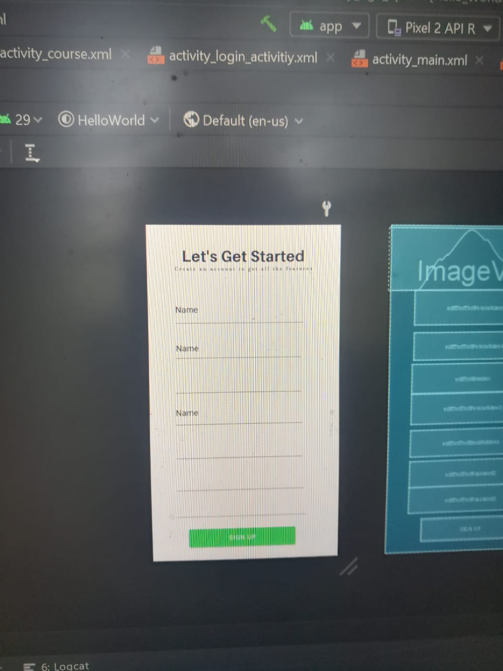
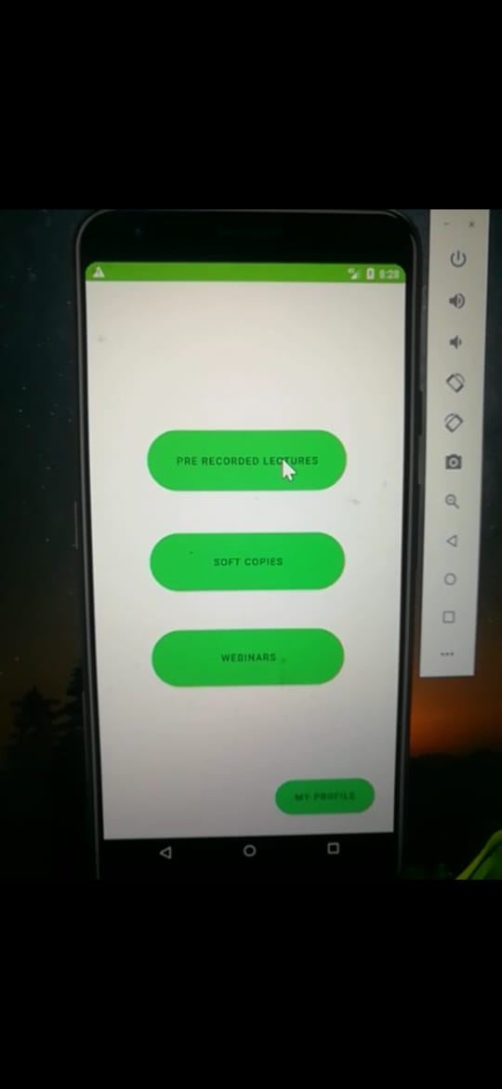

Slide 8
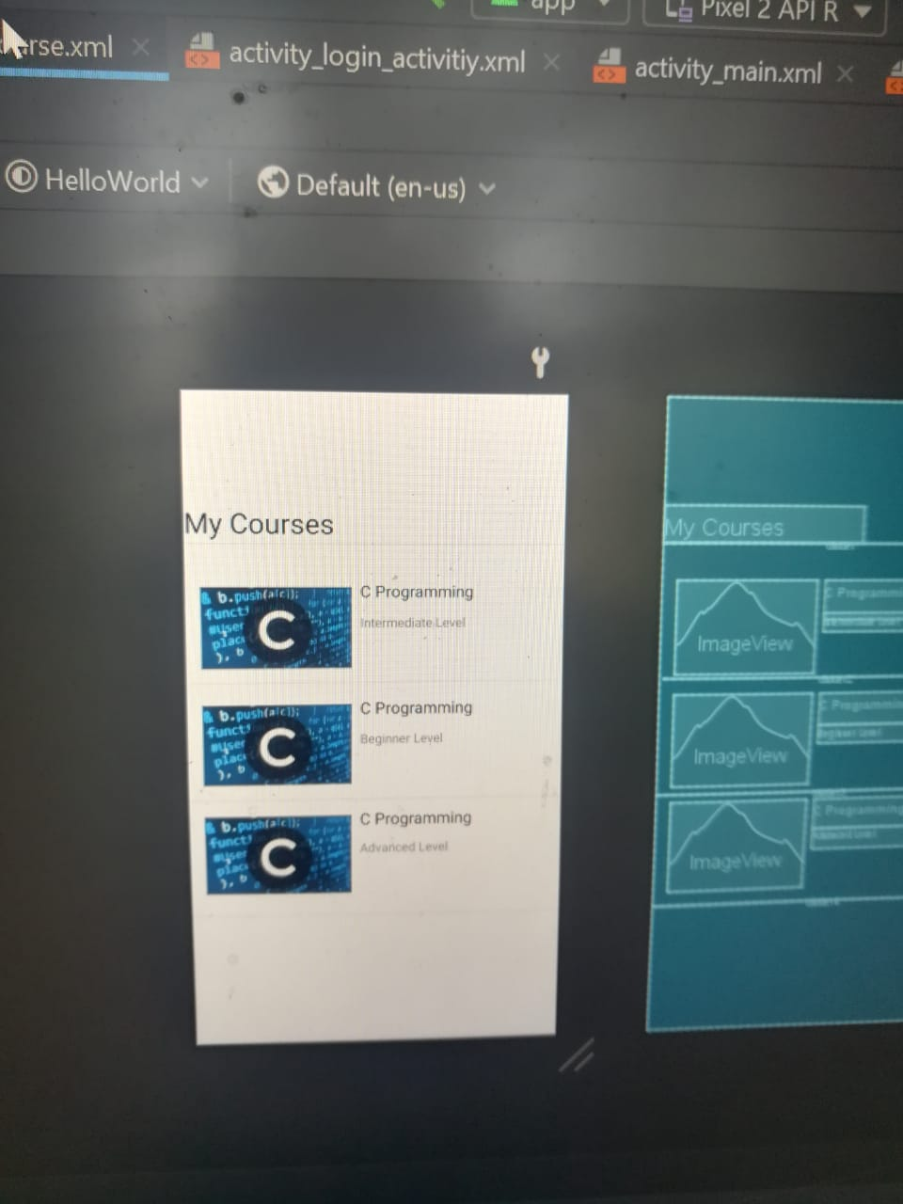
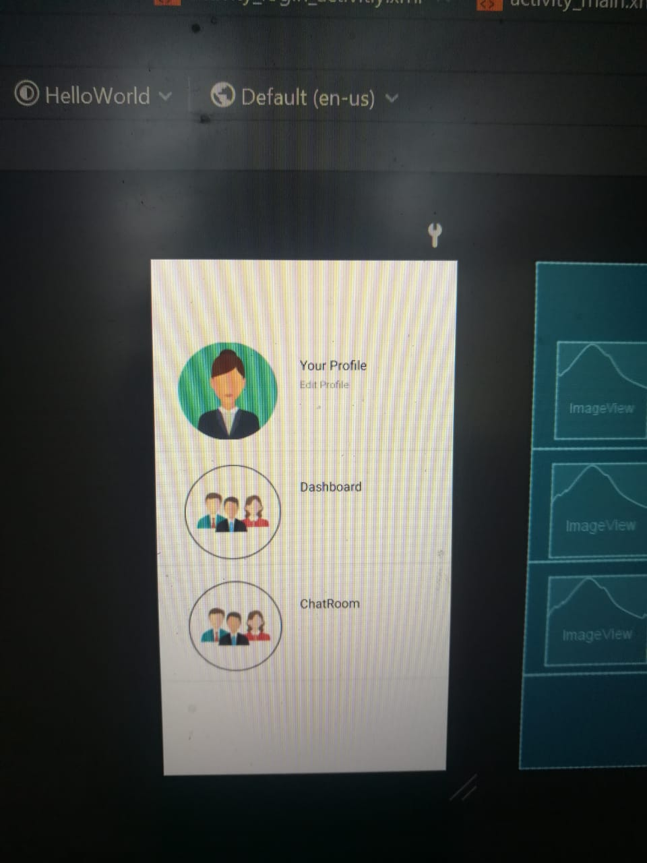
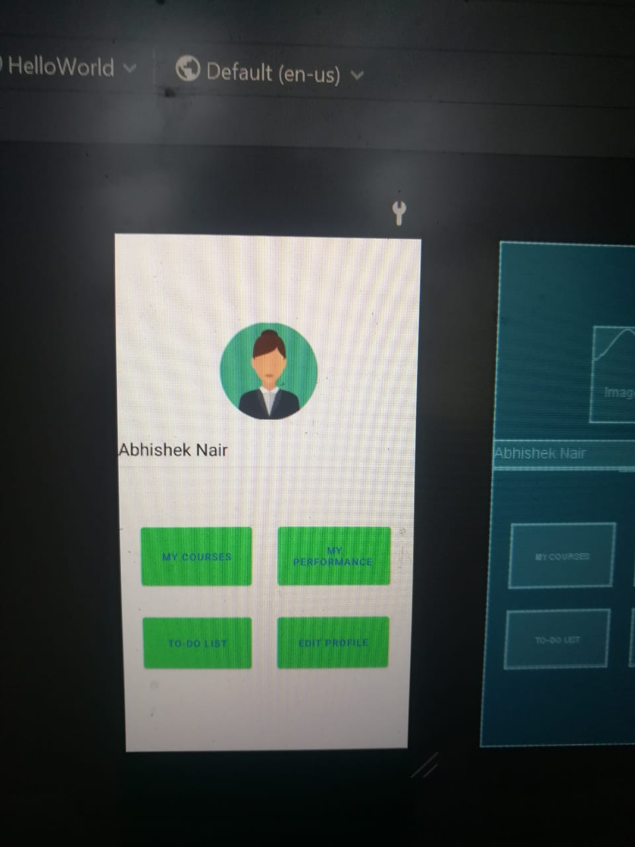

Slide 9
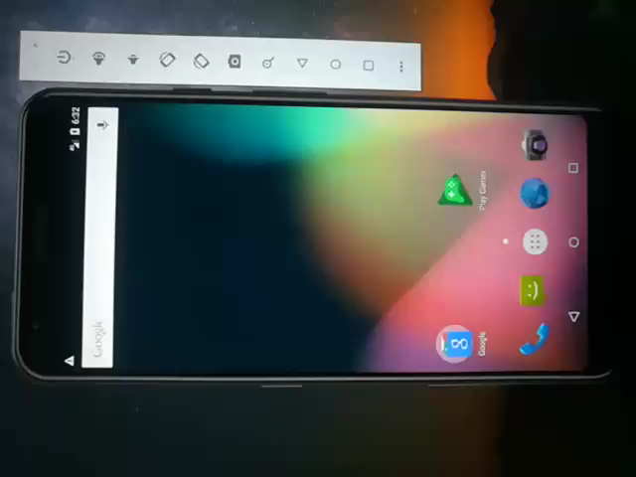
Video :

Slide 10
FEATURES:
Collaboration Of Various Learning Tools/Methods i.e. pre recorded lectures ,webinars , Notes in the form of PDFs/Documents .
Strong Reporting With Customization .
Self Registration .
A gamified education service .
A team of well educated professionals/tutors .
A chat room and a discussion forum.

Slide 11
FUTURE ENHANCEMENT :
We can Think about how to adopt the latest technologies, such as machine learning and AI, voice chatbots, AR/VR, or PWA.

Slide 12

THANK YOU !!

